Slide 1
Library Management System
Done By
Dhinakaran M
Roshan J
Sujin S S
Guided By
Dr. G Tamilpavai
Professor & head
Dept Of CSE
GCE - Tirunelveli

Slide 2
Abstract
The library management system is an application for automating the library management in college/university.
The system would provide basic set of features to add/update books & members and assist the librarian’s work.

Slide 3
Introduction
A Library management system is a software that is used to maintain the record of the books available in library.
It is a well organized software and a solution for traditional library.
Used to keep track of books issued, returned and added to library.

Slide 4
Objective
To provide a user friendly environment where user can be serviced better.
To make functioning of library faster.
To provide a system where the library staff can catch defaulters and not let them escape.

Slide 5
Existing System and Drawbacks
Drawbacks of Traditional Library System
Vulnerability to human error.
Less efficient compared to digitalized libraries.
Putting limits on the future.

Slide 6
Proposed System
Digitalized Library System
Free from errors.
Record maintenance.
Restricted access and safe architecture.
Improved reporting and monitoring.
Flawless issuance and returning of books.

Slide 7
Project Prerequisites:
tkinter – utility to design GUI
pillow – python image library
pymysql – interface for connecting to a MySQL database server from python

Slide 8
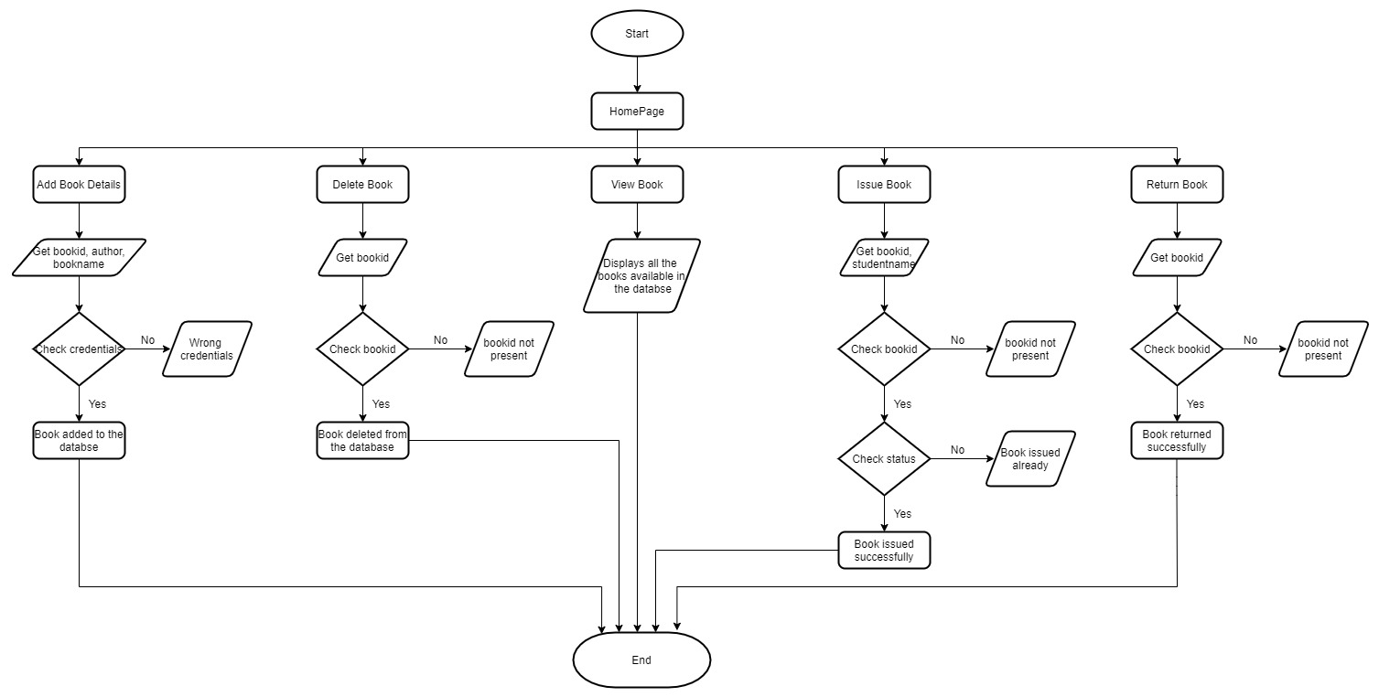
Flow Diagram

Slide 9
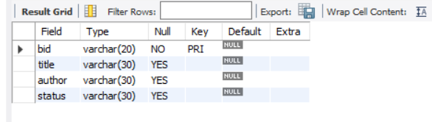
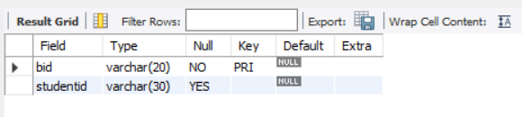
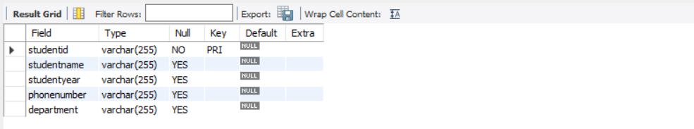
Table Design
Create tables in the database with the required fields

Slide 10
Implementation
MAIN PROGRAM
Importing the modules
Connecting to MySQL server
Designing the Window
Adding a Background image
Adding Buttons
MODULES
Add book details
Delete book
View book list
Issue book to student
Return book

Slide 11
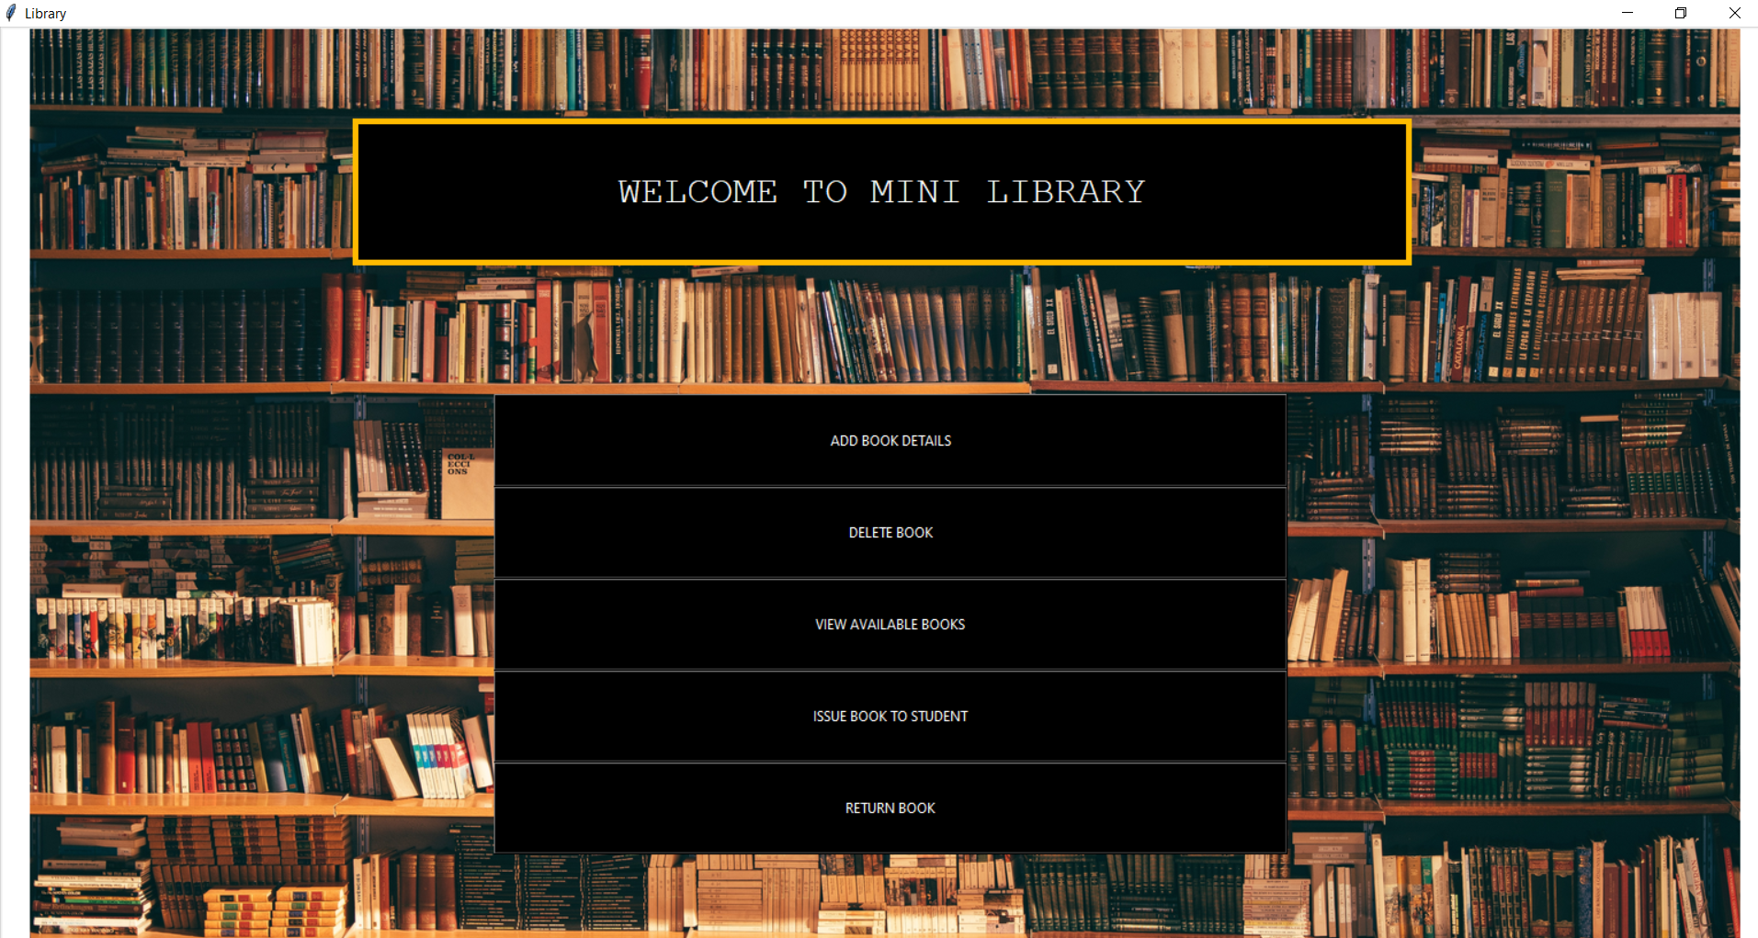
Screen Design

Slide 12
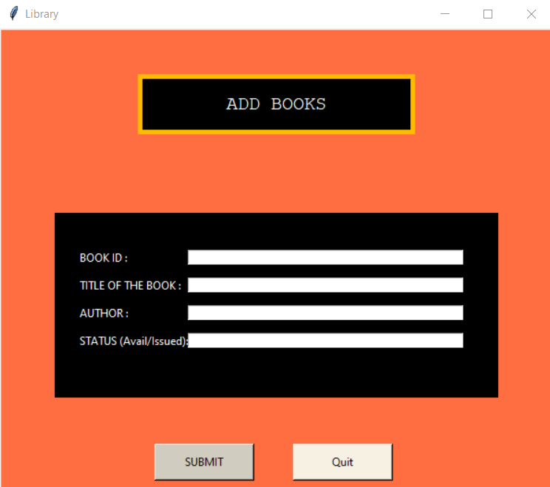
Implementation & Screen Design
ADD BOOK DETAILS (Module 1)
This module gets the data such as bookid, book title, author, status of the book and converts them into SQL command
And connects to the MySql server and creates a window for accommodating new text fields

Slide 13
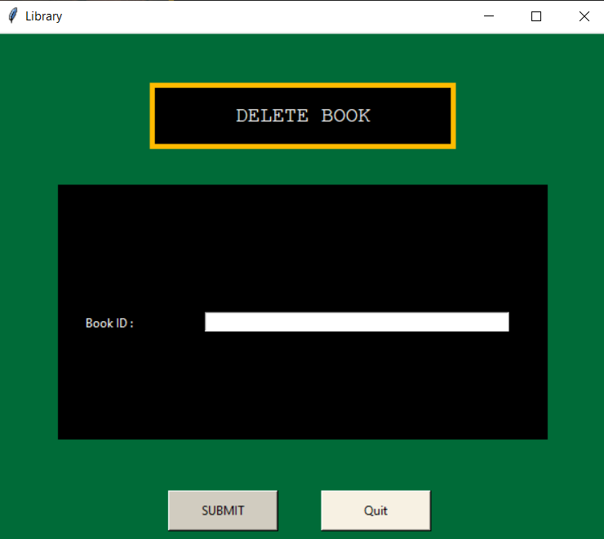
Implementation & Screen Design (cont..)
DELETE BOOK (Module 2)
In this module, the function primarily checks if the book id (bid) exists in the book table and if it does, it executes the necessary command to remove it.

Slide 14
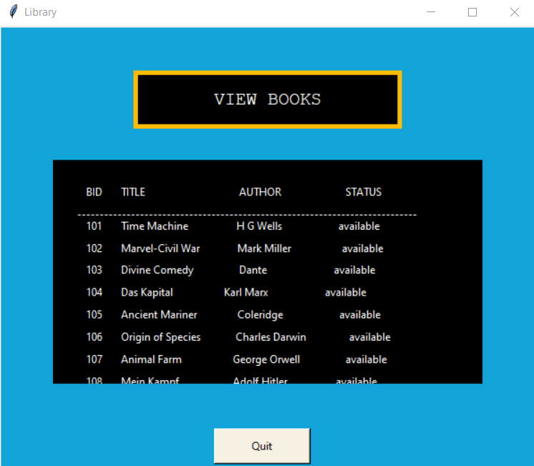
Implementation & Screen Design (cont..)
VIEW BOOK (Module 3)
This function in our library project creates a window for displaying the records in the table

Slide 15
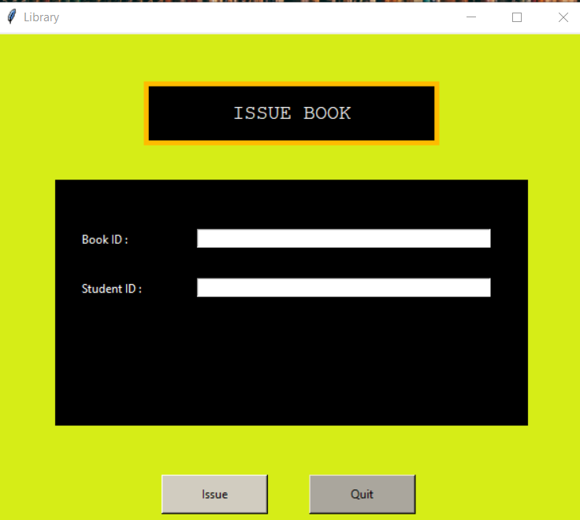
Implementation & Screen Design (cont..)
ISSUE BOOK DETAILS (Module 4)
This function fetches the desired book ID and Issuer’s name and store it into bid and studentid respectively

Slide 16
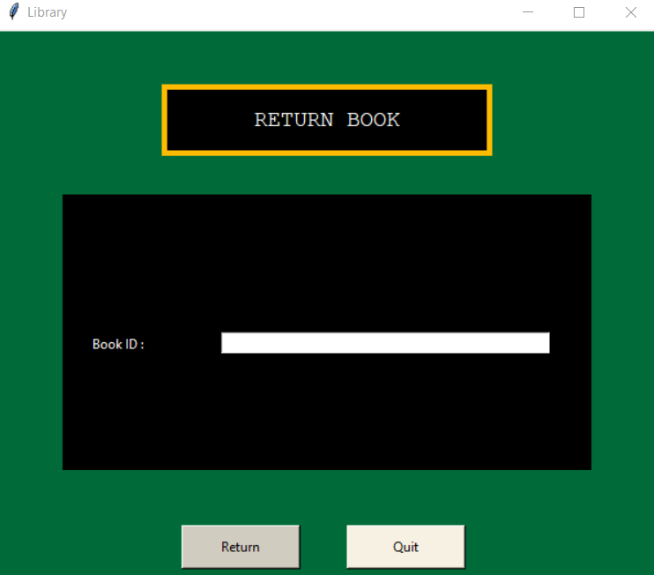
Implementation & Screen Design (cont..)
RETURN BOOK DETAILS (Module 5)
This function checks for the existence of the desired bid in the database. Also, we check the status of the same book.

Slide 17
Conclusion
The library management system allows the user to store the book details and its status in a well ordered manner.
The implementation of the system will reduce data entry time and provide readily calculated reports.

Slide 18
THANK YOU

